Slide 1
Datasets and Data Abstraction
Debajyoti Mondal
University of Saskatchewan

Slide 2
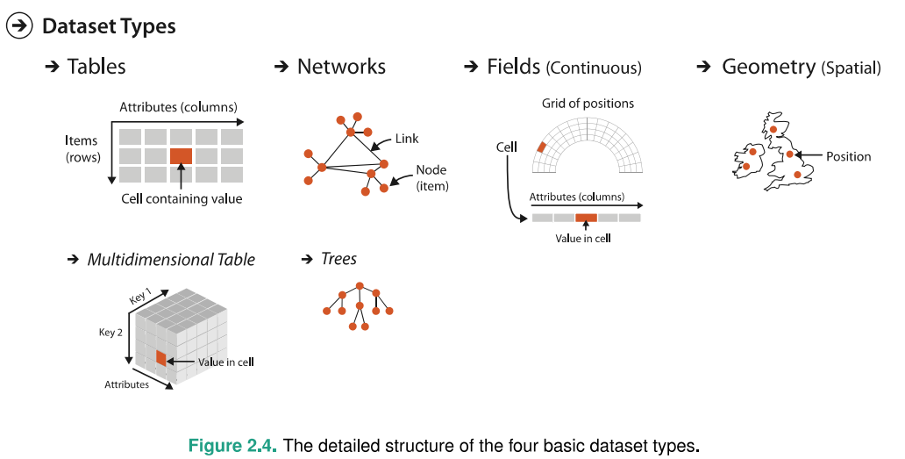
Example of Dataset Types
A Dataset is a collection of information
Notes:
In addition
cluster
List
Set
Data can be an item, a link, a grid, a position and so on.
An item is an individual entity which is discrete
A link is a relationship
A grid is a strategy for sampling continuous data
A position is a spatial data providing a 2D or 3D location

Slide 3
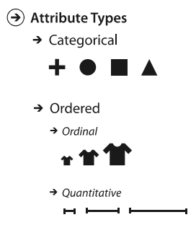
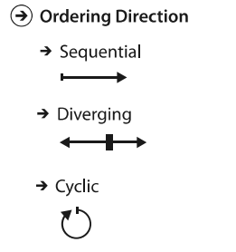



Other Properties of Data
Notes:
Attribute is some specific property of the data that can be measured.
Fruits -> Categorical -> does not have an implicit ordering -> but you can impose external ordering ‘alphabetical’ if you like
Ordinal -> has some meaningful ordering but may not support direct mathematical operation
Quantitative -> supports mathematical operation

Slide 4
Data Semantics & Type
Structural or
Mathematical
Interpretation
Real-world meaning
90210
Notes:
Info vis actually increase human capabilities.
Computer based brings interaction
One vis does not fill all demands in all areas
Major aspects: Data Collection & Analysis, Visualization Creation & Validation

Slide 5
Data Semantics & Type
Structural or
Mathematical
Interpretation
Real-world meaning
A postal code in CA → Categorical
Number of Pizza Places → Quantitative
90210

Slide 6
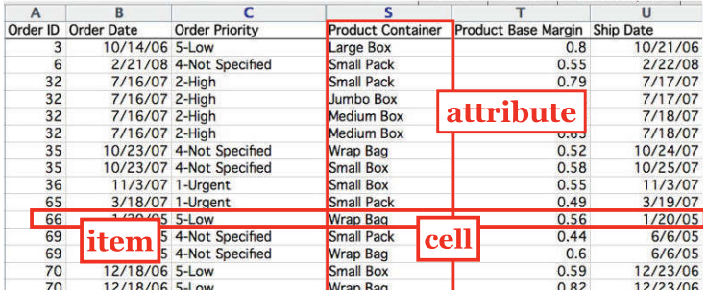

A Typical Table
Notes:
In addition
cluster
List
Set
Data can be an item, a link, a grid, a position and so on.
An item is an individual entity which is discrete
A link is a relationship
A grid is a strategy for sampling continuous data
A position is a spatial data providing a 2D or 3D location

Slide 7
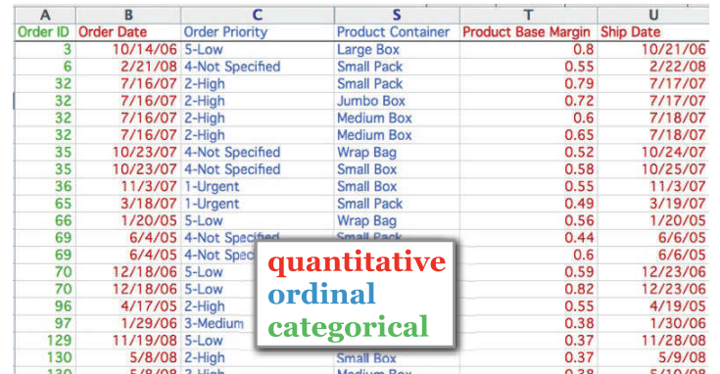
A Typical Table
Notes:
In addition
cluster
List
Set
Data can be an item, a link, a grid, a position and so on.
An item is an individual entity which is discrete
A link is a relationship
A grid is a strategy for sampling continuous data
A position is a spatial data providing a 2D or 3D location

Slide 8
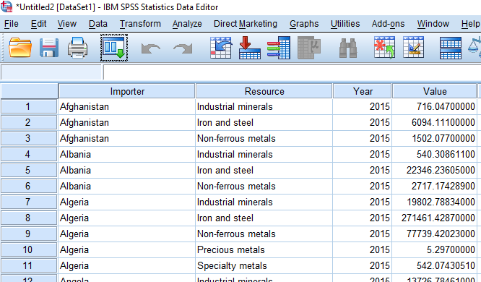
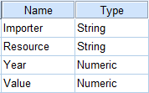
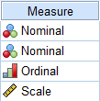
Yes, we need this in practice e.g., IBM SPSS Statistics

Slide 9
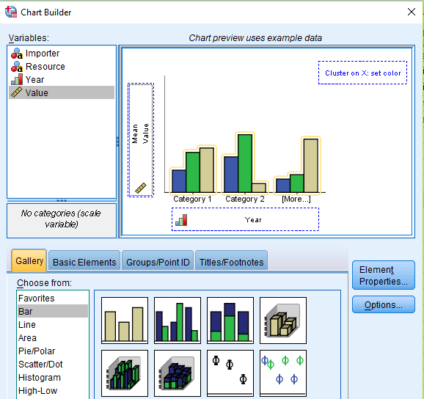


IBM SPSS Statistics
C
C
A
A
B
C

Slide 10
Class Activity
C
A
We want to examine the mean imported value for each resource.
What variables should we select for A, B, C?
Draw a hypothetical final chart.
C

Slide 11
IBM SPSS Statistics

Slide 12
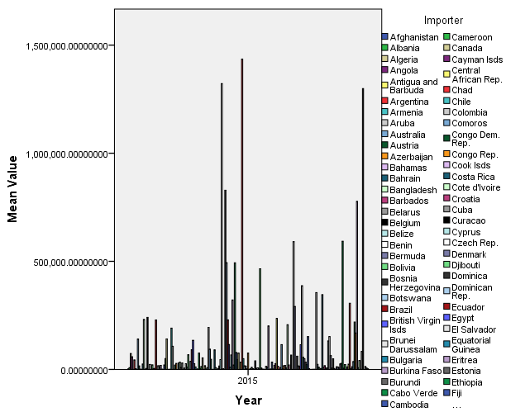
IBM SPSS Statistics

Slide 13
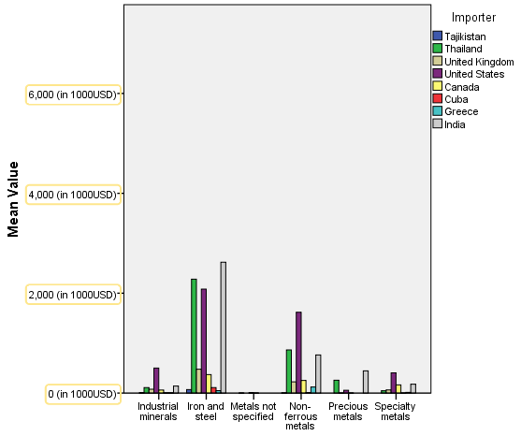
IBM SPSS Statistics

